Slide 1
Advanced Graphics & AR/VR
Richard Carufel
Prof. PJ Narayanan and Dr. Priyanka Srivastava, Dr. Avinash Sharma and Dr. Raghu Reddy

Slide 2
About the Course
This course spans over three key modules:
Module 1 - Content Generation for AR/VR
Revise computer graphics fundamentals and some advance concepts in Graphics. Introduce basic digital geometry processing techniques including point-cloud, mesh, intrinsic surface, mesh processing.
Module 2 - Virtual/Augmented Reality Cognitive: Concepts & System Design Aspects
Introduce virtual reality and augmented reality technology both at theoretical level in terms of foundation in psychology, human vision, technology as well as system building aspects related to designing such systems.

Slide 3
About the Course Project
A list of projects will be shared.
Should focus on AR/VR system building.
Team of maximum 2-3 students.
Project will run in parallel to classes.
Write a 8-15 pages report summarising your efforts/results
2 presentations (mid semester and final evaluation).
Code should synced up on git.

Slide 4
About the Course
Weekly 2 lectures
3 - 4 Expert Lectures
1 Tutorial sessions every week.
Multiple Assignments.
Only one exam based evaluation.
One course project.
TA’s: Swaraj R. & Anirudh R.
Tentative Credit Distribution
Course Project Demo/viva: 30%
Assignments: (5*7): 35%
Mid Exam: 25%
Final Viva: 10%
Strictly, no plagiarism: Any detected case of plagiarism to be taken seriously.

Slide 5
Understating the Audience
Expected to be research oriented and self-motivated
Large variation in academic exposure
Those who have done UG2 course on CG.
Those who have attended the 3DVSS summer school.
MS/PhD/Hons vs BTech (PGSSP/CSE/ECE) students

Slide 6
Module 2- Virtual/Augmented Reality: Cognitive Concepts & System Design Aspects

Slide 7
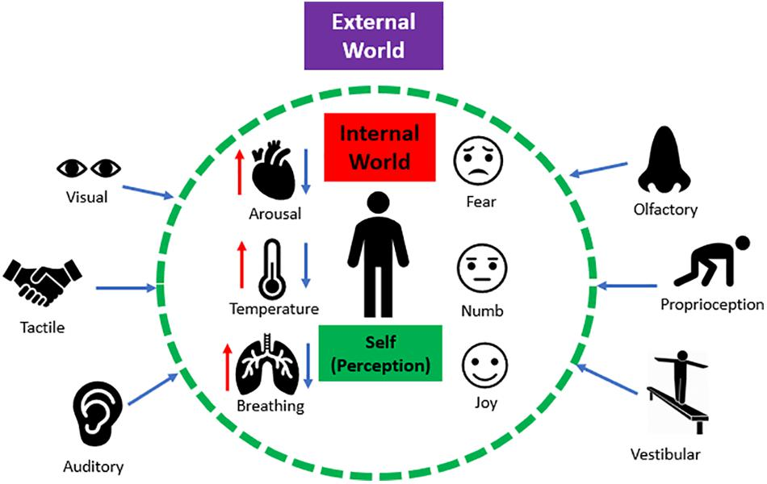
Making Sense of the World

Slide 8
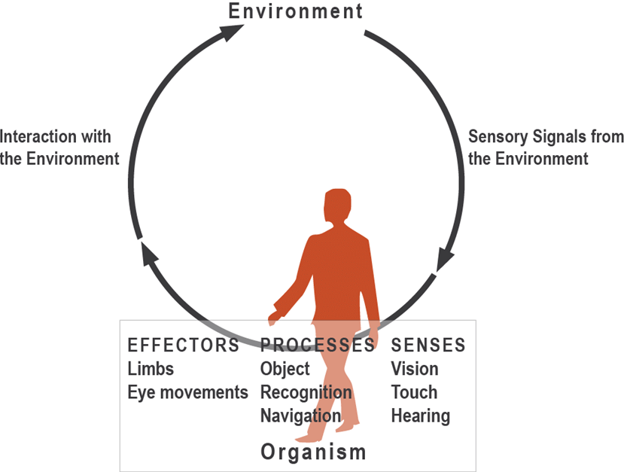
Perception-Action Cycle

Slide 9

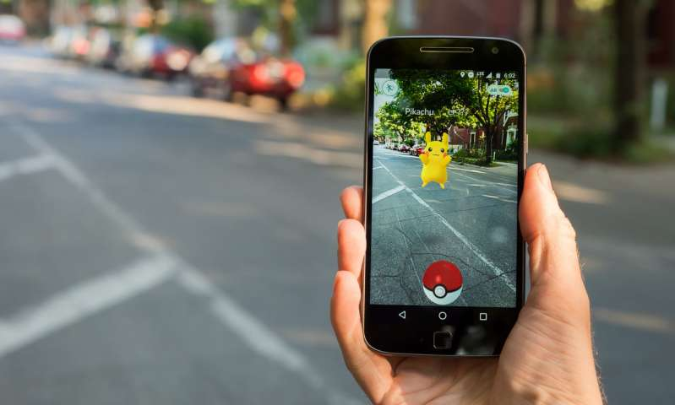
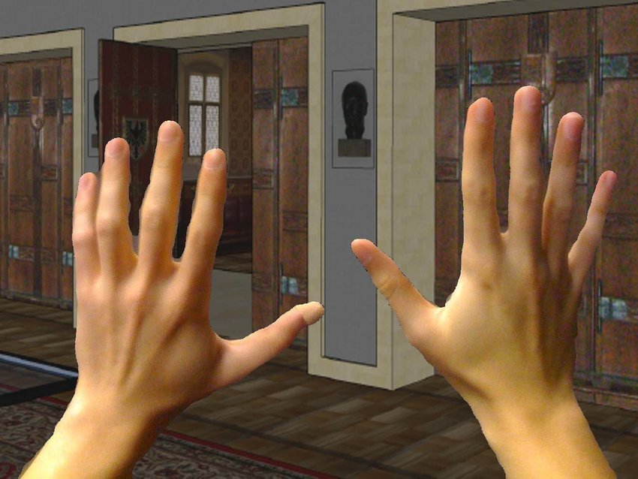
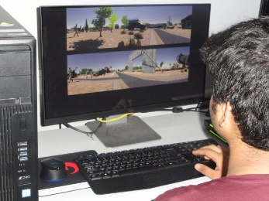
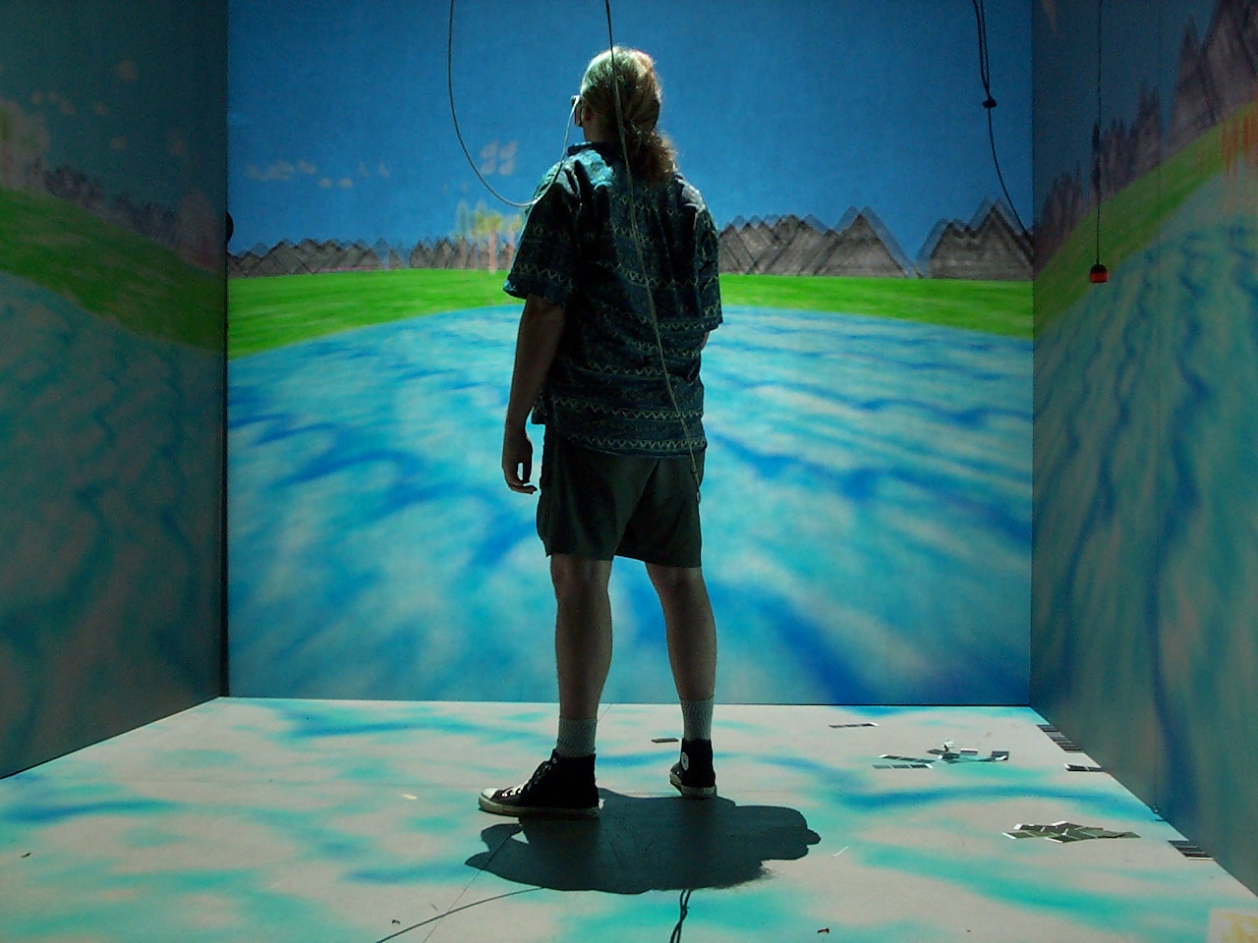
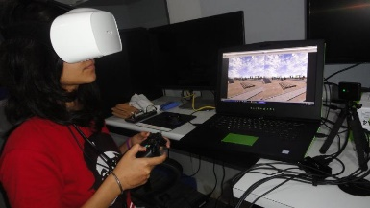
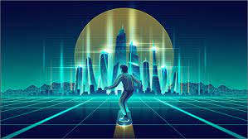
REALITY SPECTRUM
REAL
PHYSICAL
WORLD
AUGMENTED REALITY
VIRTUAL REALITY
Metaverse
Notes:
What makes you believe that its real ?

Slide 10
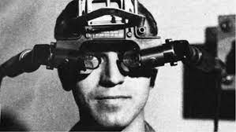
VR: The Ultimate Display
The ‘ultimate display’ is a conceptual device that aims to resemble reality and blurs the boundaries between the physical and the computer-generated artificial world.
More importantly, it envisions transcending the physical space and opens a window to examine the ability to perceive-think-and-act, a phenomenological experience of feeling and consciousness by enabling controls that oppose the rules of physical reality and yet create a sense of presence.
(Ivan Sutherland, 1965)
Notes:
Other issues with current traditional methods of observations – focusing on digitizing and including ubiquitious as mobile and as emergining tech like VR and metaverse
Highlight the immersion and sense of presence
The VR sickness and why that happens

Slide 11
Topics to be covered
Virtual Reality – if its covered I’ll merge it with other topics.
Immersion and Presence
VR induced sickness
Notes:
Other issues with current traditional methods of observations – focusing on digitizing and including ubiquitious as mobile and as emergining tech like VR and metaverse
Highlight the immersion and sense of presence
The VR sickness and why that happens

Slide 12
Module 1- Content Generation for AR/VR

Slide 13
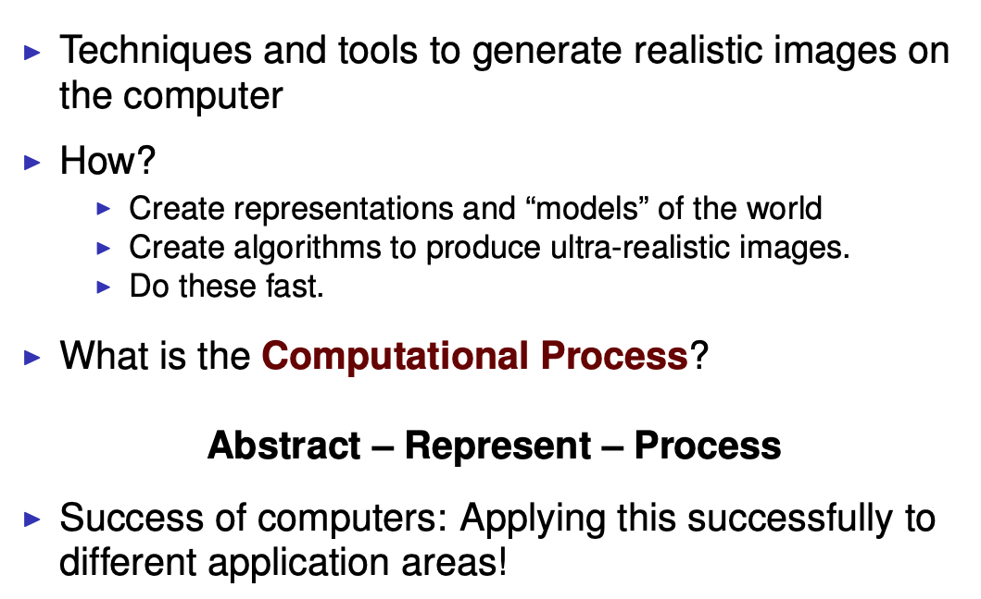
Computer Graphics

Slide 14
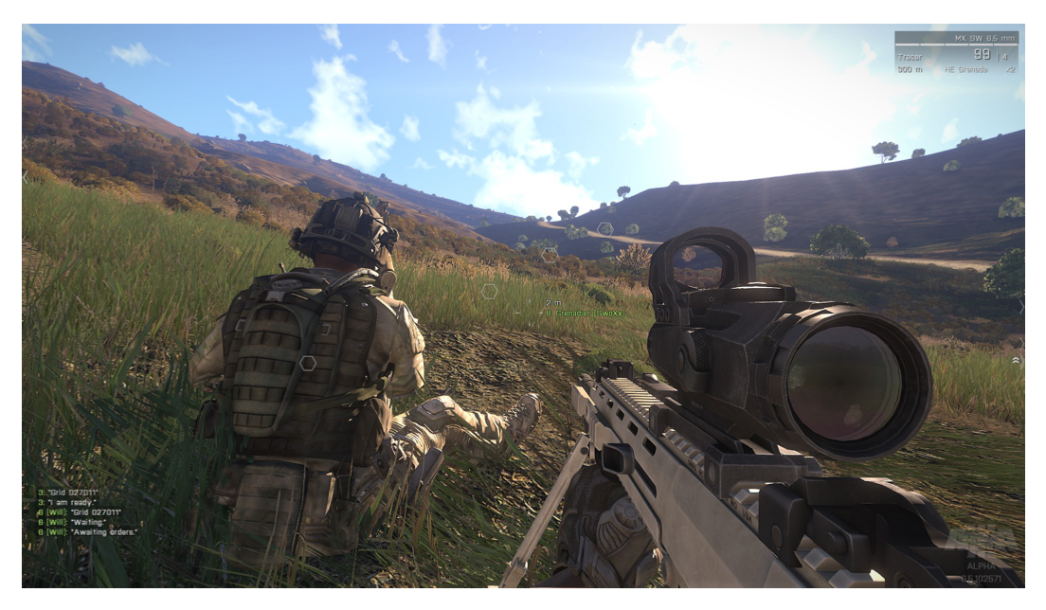
Is this real or Computer Generated?

Slide 15
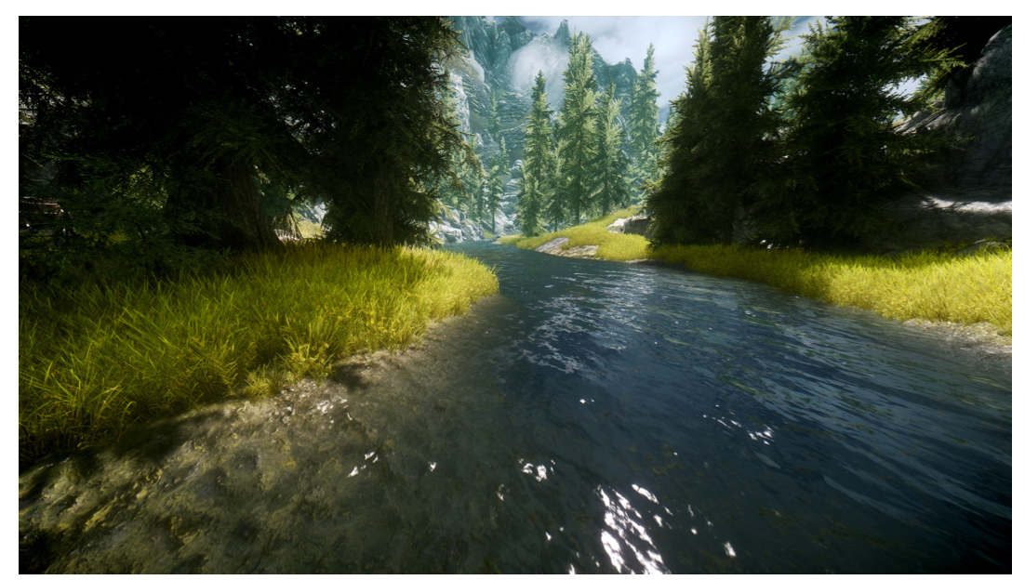
Is this real or Computer Generated?

Slide 16
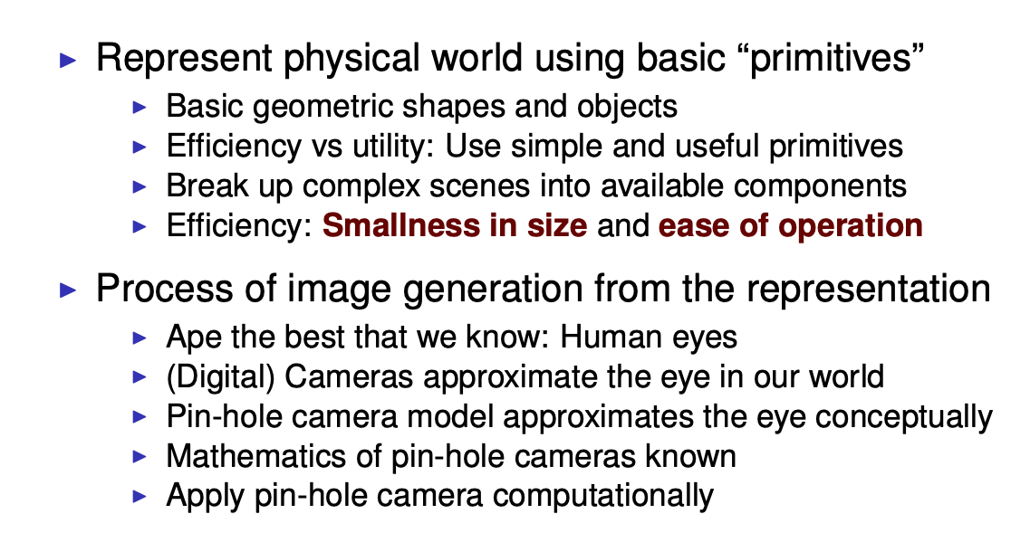
Producing Realistic Images

Slide 17
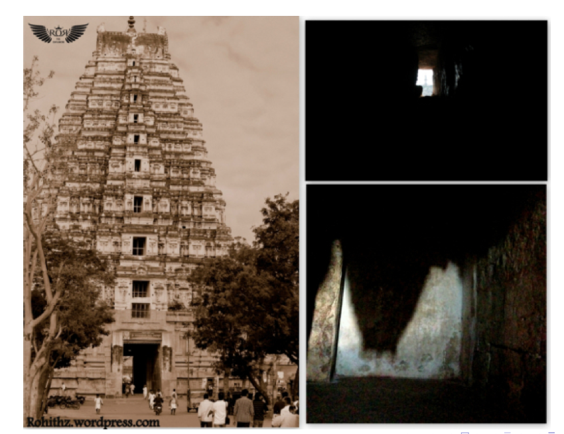
Pin-hole Camera Model

Slide 18
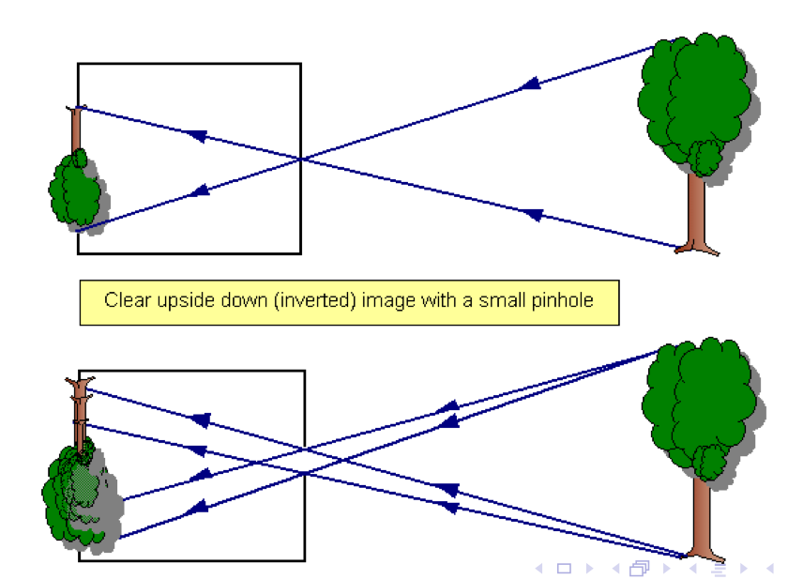
Pin-hole Camera Model

Slide 19
Human Vision Setup
Image Source: micro.magnet.fsu.edu//

Slide 20
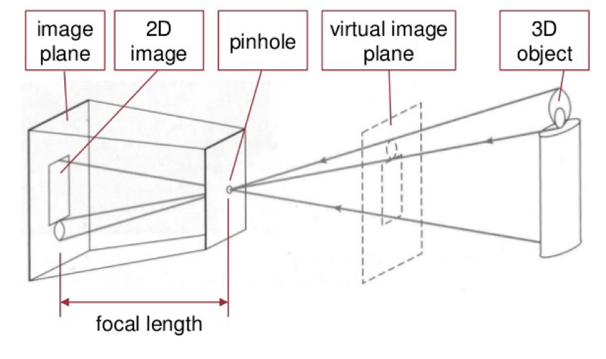
Pin-hole Camera Model

Slide 21
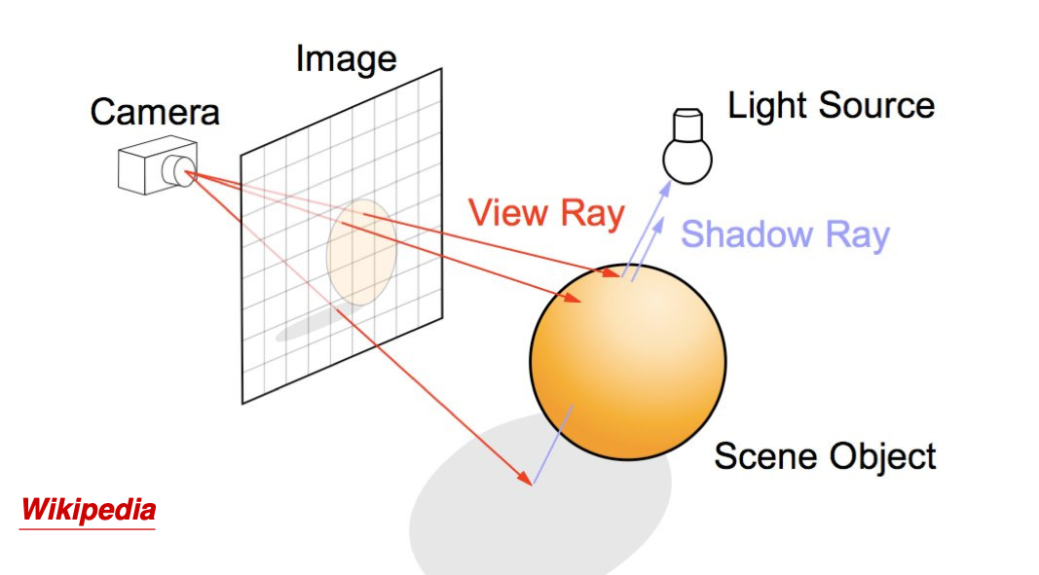
Image Formation in
Light Source
Virtual Camera
3D Object
Virtual Image Place

Slide 22
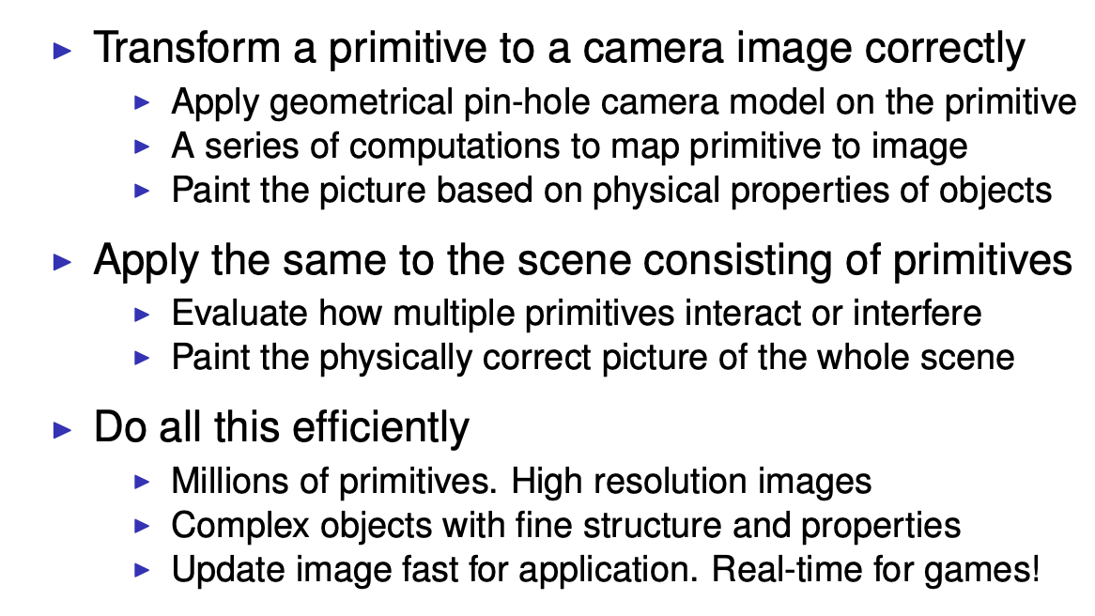
Producing Realistic Images

Slide 23
Image Formation

Slide 24
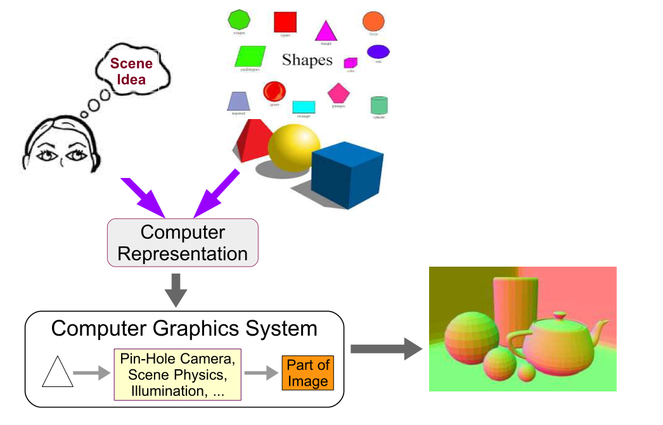
Graphics Process

Slide 25
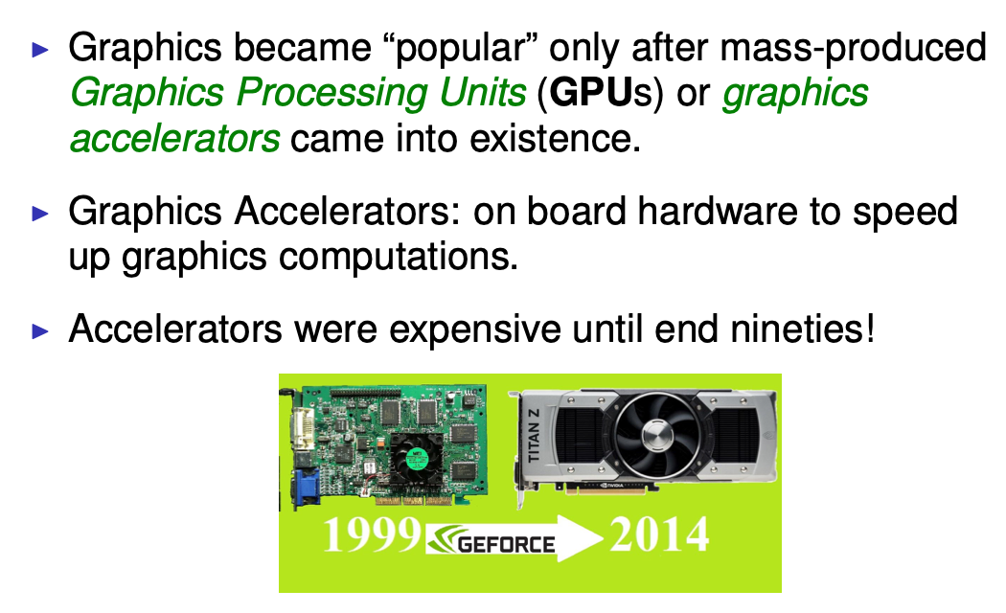
GPU Revolution

Slide 26
Thank You !
Questions ?

